Slide 1
Devops – CI/CD

Slide 2
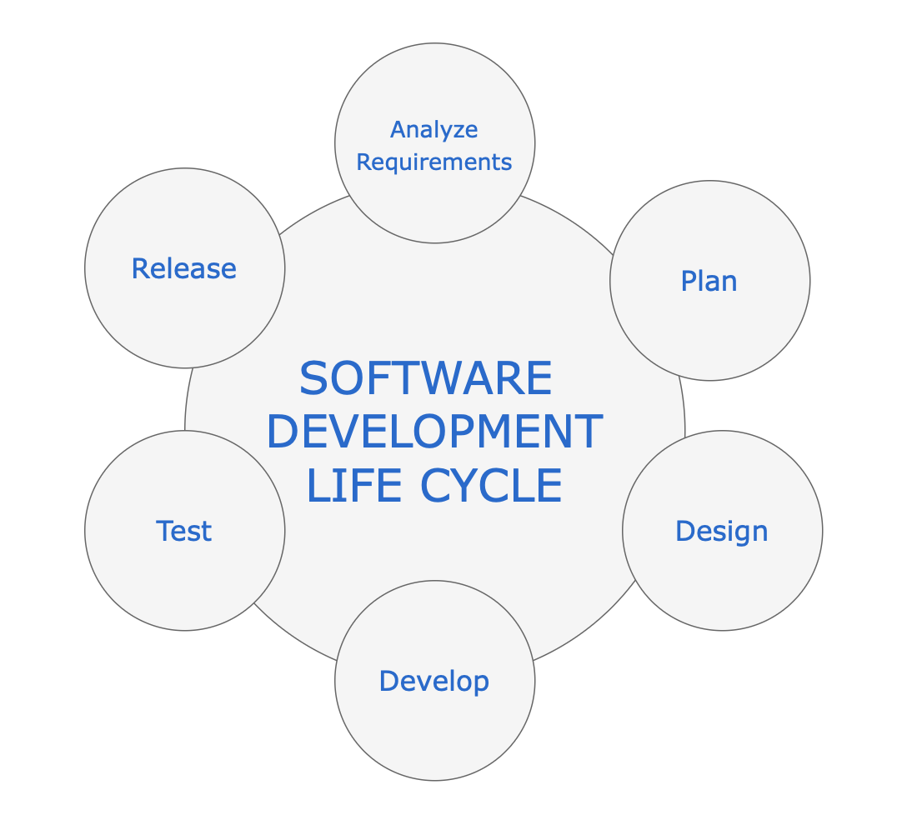
Software Development Life Cycle
Software development follows a flow, starting with identifying new features, planning, doing the actual development, committing the source code changes, running builds and tests (unit, integration, functional, acceptance, etc.), and deploying to production.
With a traditional waterfall software delivery approach, developers could work independently for a very long time. They would not have a clue about how many issues they would run into during the integration phase.

Slide 3
SDLC
In order to address this issue, the Agile software development model was introduced. Agile changed the way software development teams worked. One of the key principles of this methodology was delivering working software frequently. The focus moved to releasing incremental software, rather than big bang waterfall releases which took months and years.
Delivering software frequently meant producing stable code for every incremental release. It was quite a challenge to integrate changes from various developers on the teams. This led to software teams looking for better approaches. Continuous Integration (CI) offered a ray of hope and started to gain in popularity.

Slide 4
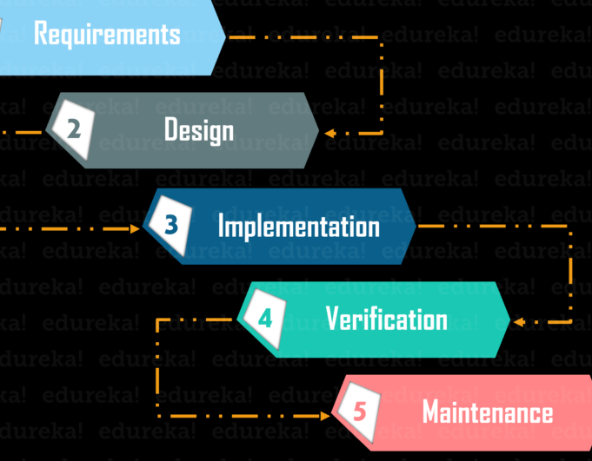
History of DevOps
Before DevOps, We had two approaches for software development namely the Waterfall and the Agile.
Waterfall Model
The waterfall model is a software development model that is pretty straight forward and linear. This model follows a top-down approach.
This model has various starting with Requirements gathering and analysis. This is the phase where you get the requirements from the client for developing an application. After this, you try to analyze these requirements.

Slide 5

WaterFall Model
The next phase is the Design phase where you prepare a blueprint of the software. Here, you think about how the software is actually going to look like.
Once the design is ready, you move further with the Implementation phase where you begin with the coding for the application. The team of developers works together on various components of the application.
Once you complete the application development, you test it in the Verification phase. There are various tests conducted on the application such as unit testing, integration testing, performance testing, etc.
After all the tests on the application are completed, it is deployed onto the production servers.
At last, comes the Maintenance phase. In this phase, the application is monitored for performance. Any issues related to the performance of the application are resolved in this phase.

Slide 6

Advantages and Disadvantages
Advantages of the Waterfall Model:
Simple to understand and use
Allows for easy testing and analysis
Saves a significant amount of time and money
Good for small projects if all requirements are clearly defined
Allows for departmentalization & managerial control
Disadvantages of Waterfall Model:
Risky and uncertain
Lack of visibility of the current progress
Not suitable when the requirements keep changing
Difficult to make changes to the product when it is in the testing phase
The end product is available only at the end of the cycle
Not suitable for large and complex projects

Slide 7
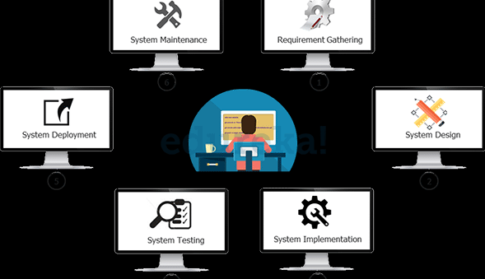
Waterfall Model
Let’s consider developing software in a traditional way using a Waterfall Model.
In the above diagram you will see the phases it will involve:
­In phase 1 – Complete Requirement is gathered and SRS is developed
In phase 2 – This System is Planned and Designed using the SRS
In phase 3 – Implementation of the System takes place
In phase 4 – System is tested and its quality is assured
In phase 5 – System is deployed to the end users
In phase 6 – Regular Maintenance of the system is done

Slide 8
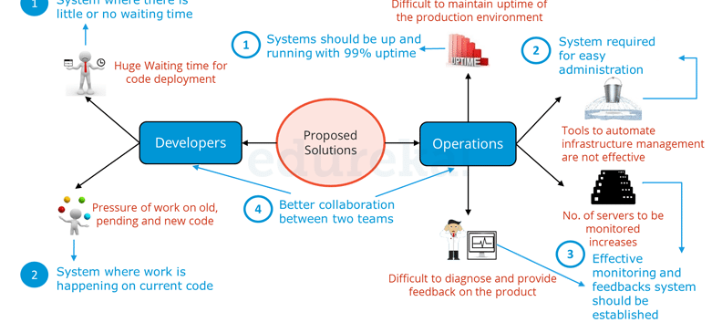
Waterfall Model Challenges
The Water-fall model worked fine and served well for many years however it had some challenges. In the following diagram the challenges of Waterfall Model are highlighted.
Both Development and Operations had challenges in the Waterfall Model. From Developers point of view there were majorly two challenges:
After Development, the code deployment time was huge.
Pressure of work on old, pending and new code was high because development and deployment time was high.
On the other hand, Operations was also not completely satisfied. There were four major challenges they faced as per the above diagram:
It was difficult to maintain ~100% uptime of the production environment.
Infrastructure Automation tools were not very affective.
Number of severs to be monitored keeps on increasing with time and hence the complexity.
It was very difficult to provide feedback and diagnose issue in the product.

Slide 9
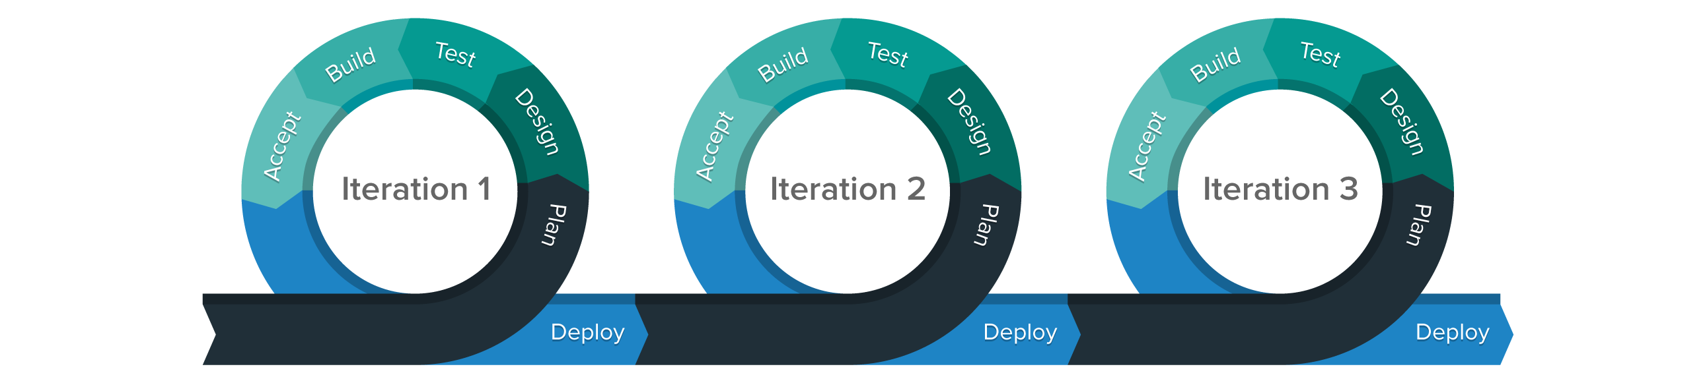
Agile Methodology
Agile Methodology is an iterative based software development approach where the software project is broken down into various iterations or sprints. Each iteration has phases like the waterfall model such as Requirements Gathering, Design, Development, Testing, and Maintenance. The duration of each iteration is generally 2-8 weeks.
Agile Process
In Agile, a company releases the application with some high priority features in the first iteration.
After its release, the end-users or the customers give you feedback about the performance of the application.
Then you make the necessary changes into the application along with some new features and the application is again released which is the second iteration.
You repeat this entire procedure until you achieve the desired software quality.

Slide 10
Advantages and Disadvantages
Advantages of Agile Model
It adaptively responds to requirement changes favorably
Fixing errors early in the development process makes this process more cost-effective
Improves the quality of the product and makes it highly error-free
Allows for direct communication between people involved in software project
Highly suitable for large & long-term projects
Minimum resource requirements & very easy to manage
Disadvantages of Agile Model
Highly dependent on clear customer requirements
Quite Difficult to predict time and effort for larger projects
Not suitable for complex projects
Lacks documentation efficiency
Increased maintainability risks

Slide 11
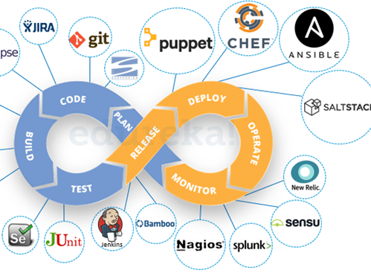
What is DevOps?
The term DevOps is a combination of two words namely Development and Operations. DevOps is a practice that allows a single team to manage the entire application development life cycle, that is, development, testing, deployment, and monitoring.
The ultimate goal of DevOps is to decrease the duration of the system’s development life cycle while delivering features, fixes, and updates frequently in close synchronization with business objectives.
DevOps is a software development approach with the help of which you can develop superior quality software quickly and with more reliability. It consists of various stages such as continuous development, continuous integration, continuous testing, continuous deployment, and continuous monitoring.

Slide 12
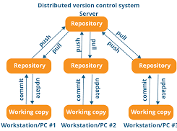
DevOps Stages and Tools
The various stages such as continuous development, continuous integration, continuous testing, continuous deployment, and continuous monitoring constitute the DevOps Life cycle.
Stage – 1: Continuous Development
Tools Used: Git, SVN, Mercurial, CVS
Process Flow:
This is the phase that involves ‘planning‘ and ‘coding‘ of the software. You decide the project vision during the planning phase and the developers begin developing the code for the application.
There are no DevOps tools that are required for planning, but there are a number of tools for maintaining the code.
The code can be in any language, but you maintain it by using Version Control tools. This process of maintaining the code is known as Source Code Management.
After the code is developed, then you move to the Continuous Integration phase.

Slide 13
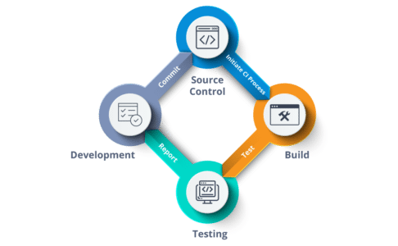
Stage – 2: Continuous Integration
Tools: Jenkins, TeamCity, Travis
Process Flow:
This stage is the core of the entire DevOps life cycle. It is a practice in which the developers require to commit changes to the source code more frequently. This may be either on a daily or weekly basis.
You then build every commit, and this allows early detection of problems if they are present. Building code not only involves compilation but it also includes code review, unit testing, integration testing, and packaging.
The code supporting new functionality is continuously integrated with the existing code. Since there is a continuous development of software, you need to integrate the updated code continuously as well as smoothly with the systems to reflect changes to the end-users.
In this stage, you use the tools for building/ packaging the code into an executable file so that you can forward it to the next phases.

Slide 14
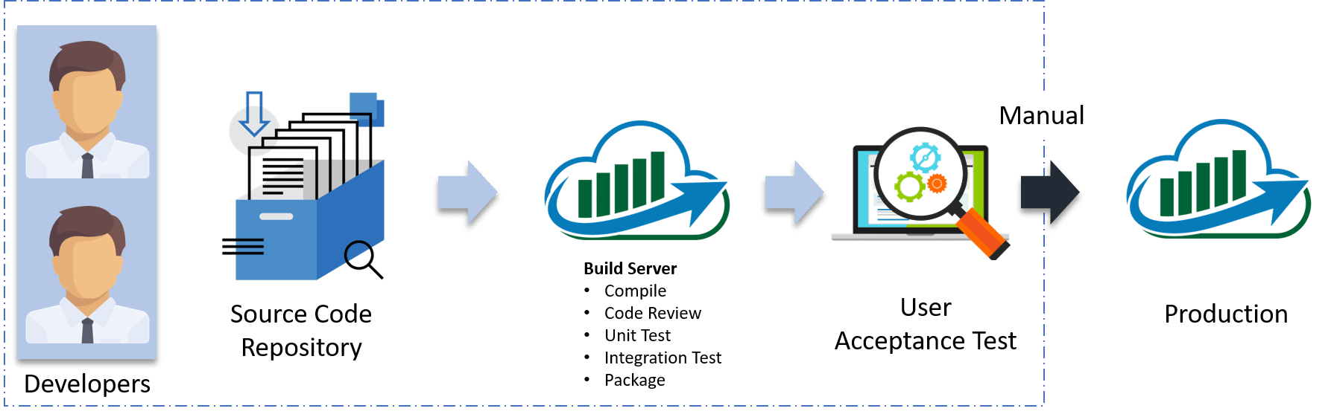
Stage – 3: Continuous Testing
Tools: Jenkins, Selenium TestNG, JUnit
Process Flow:
This is the stage where you test the developed software continuously for bugs using automation testing tools. These tools allow QAs to test multiple code-bases thoroughly in parallel to ensure that there are no flaws in the functionality. In this phase, you can use Docker Containers for simulating the test environment.
Selenium is used for automation testing, and the reports are generated by TestNG. You can automate this entire testing phase with the help of a Continuous Integration tool called Jenkins.
Suppose you have written a selenium code in Java to test your application. Now you can build this code using ant or maven. Once you build the code, you then test it for User Acceptance Testing (UAT). This entire process can be automated using Jenkins.

Slide 15
Stage – 4: Continuous Deployment
Configuration Management – Chef, Puppet, Ansible
Containerization – Docker, Vagrant
Process Flow:
This is the stage where you deploy the code on the production servers. It is also important to ensure that you correctly deploy the code on all the servers. Before moving on, let us try to understand a few things about Configuration management and Containerization tools. These set of tools here help in achieving Continuous Deployment (CD).
Configuration Management is the act of establishing and maintaining consistency in an application’s functional requirements and performance. Let me put this in easier words, it is the act of releasing deployments to servers, scheduling updates on all servers and most importantly keeping the configurations consistent across all the servers.
Containerization tools also play an equally crucial role in the deployment stage. The containerization tools help produce consistency across Development, Test, Staging as well as Production environments. Besides this, they also help in scaling-up and scaling-down of instances swiftly.

Slide 16
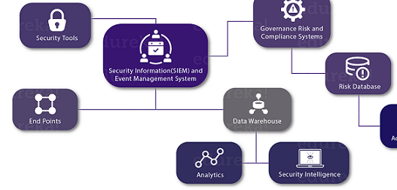
Stage – 5: Continuous Monitoring
Tools Used: Splunk, ELK Stack, Nagios, New Relic
Process Flow:
This is a very critical stage of the DevOps life cycle where you continuously monitor the performance of your application. Here you record vital information about the use of the software. You then process this information to check the proper functionality of the application. You resolve system errors such as low memory, server not reachable, etc in this phase.
This is a very critical stage of the DevOps life cycle where you continuously monitor the performance of your application. Here you record vital information about the use of the software. You then process this information to check the proper functionality of the application. You resolve system errors such as low memory, server not reachable, etc in this phase.

Slide 17
DevOps vs Agile! Everything You Need To Know
Features | DevOps | Agile
Agility | Agility in both Development & Operations | Agility in only Development
Processes/ Practices | Involves processes such as CI, CD, CT, etc. | Involves practices such as Agile Scrum, Agile Kanban, etc.
Key Focus Area | Timeliness & quality have equal priority | Timeliness is the main priority
Release Cycles/ Development Sprints | Smaller release cycles with immediate feedback | Smaller release cycles
Source of Feedback | Feedback is from self (Monitoring tools) | Feedback is from customers
Scope of Work | Agility & need for Automation | Agility only
Why Is DevOps Better Than Agile?
Agile software development is about following a set of best practices for creating quality software in a timely manner. But the problem is, the best practices followed, involves people working in Silos.
By Silos, I mean there are people who will be working as Developers, or as Testers, or as ITOps with very little communication between them. And since, there is very little communication between them, they are not aware what the others are working on despite being a part of the same process.
This Silos-ed working of teams is the reason for the infamous “Blame Game” that goes about when a software fails or has major flaws.

Slide 18
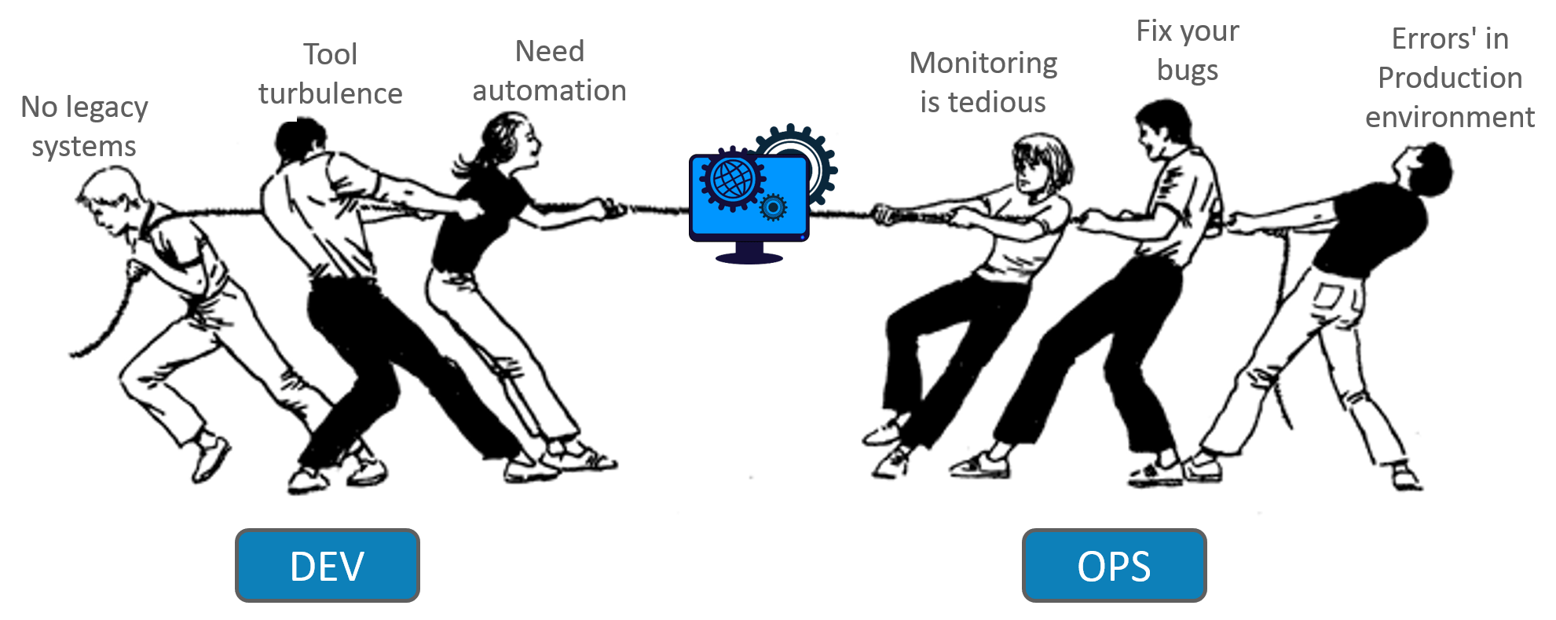
The Blame Game
When a client has complains about a software, the blame is internally thrown at each other. The ‘Dev’ team would point fingers at the ‘QA’ team. ‘QA’ team will then point fingers at the ‘ITOps’ team, who would redirect the blame to the ‘Dev’ team.
Irrespective of the problem residing in the code developed, or on the systems where the code is deployed, the problem remains in isolation, as nobody wants to take ownership for the screw-up.

Slide 19
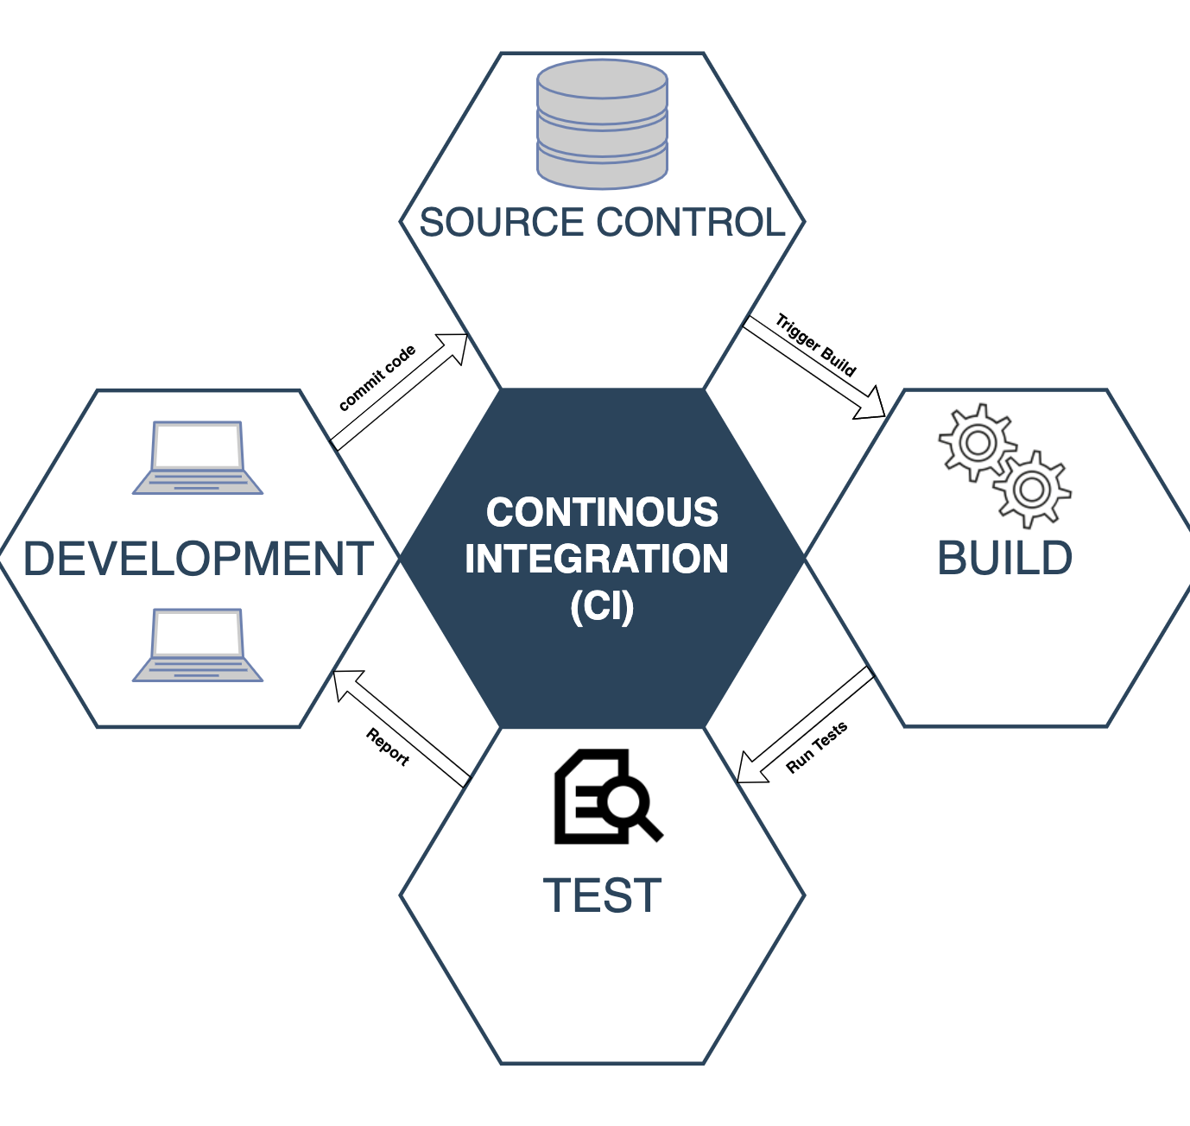
Continuous Integration (CI)
Continuous Integration is an agile engineering practice originating from the extreme programming methodology. It primarily focuses on automated build and test for every change committed to the version control system by the developers.
According to Martin Fowler,
"Continuous Integration (CI) is a software development practice where members of a team integrate their work frequently; usually each person integrates at least daily - leading to multiple integrations per day. Each integration is verified by an automated build (including test) to detect integration errors as quickly as possible".

Slide 20
In order to implement Continuous Integration, you will need:
A version control system It stores all the source code checked in by the teams, and acts as the single source of truth.
Automated build and unit test It is not sufficient if the code written by a developer works only on his/her machine. Every commit that makes it to the version control system should be built and tested by an independent continuous integration server.
Feedback Developers should get feedback on their commits. Anytime a developer’s change breaks the build, they can take the necessary action (example: email notifications).
Agreement on ways of working It is important that everyone on the team follows the practice of checking-in incremental changes rather than waiting till they are fully developed. Their priority should be to fix any build issues that may arise with the checked-in code.

Slide 21
DevOps Movement
Continuous Integration primarily solves the development part of the workflow. However, there is more to software delivery than just feature development and integrating the changes. There is testing (manual, automated) and release process (actual deployment to customer or production).
In the pre-DevOps era, each team was responsible for their own work. The development team would take care of feature development. That’s where their job ended. They would then throw it on over to the quality assurance (QA) team. The QA team would run all the extended test suites (manual and automated). If things worked fine, they would hand the features off to the operations team, who would then ultimately roll out the new features into production and manage them.
Each of these teams worked in silos. The release processes were mostly manual and error prone leading to longer and painful release cycles. Every time something went wrong, a massive amount of time was spent trying to get to the root cause of the issue, let alone the blame game. All this resulted in a lot of wasted time at various levels of the organization.

Slide 22
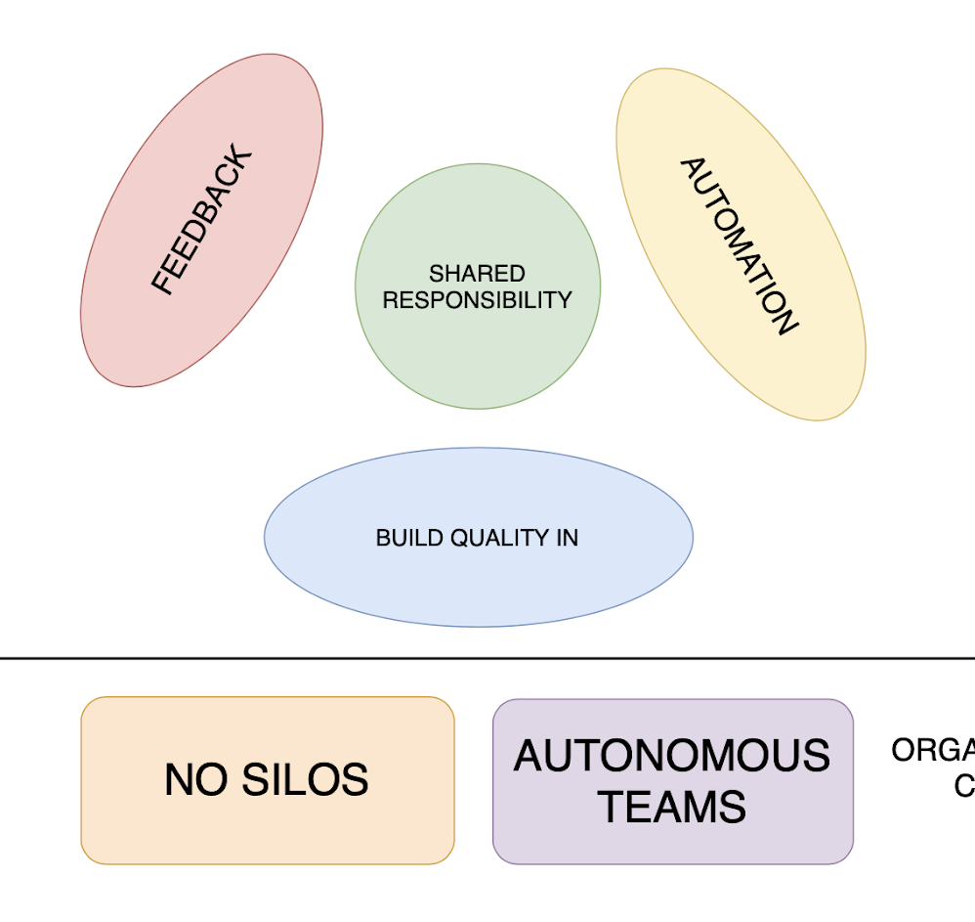
Devops Movement Continued..
In reality, every single team should be equally responsible for the release of the new software, which means all these teams need to work in close collaboration with each other. The DevOps movement, which originated from Agile software development, strongly emphasizes the need for collaboration amongst the various teams involved in the software delivery process. In addition to close collaboration, automation of each of the stages of the software delivery process and constant feedback cycles are also considered extremely important. Continuous Delivery provides a framework to achieve the goals of DevOps through automation, and continuous feedback loops.

Slide 23
Continuous Delivery
Continuous Delivery is a logical extension of Continuous Integration. While Continuous Integration lets you automate the software build and test process, Continuous Delivery automates the full application delivery process by taking any change in code (new features, bug fixes, etc.) all the way from development (code commit) to deployment (to environments such as staging and production). It ensures that you are able to release new changes to your customers quickly in a reliable and repeatable manner.
According to Martin Fowler, who coined the term Continuous Delivery,
"Continuous Delivery is a software development discipline where you build software in such a way that the software can be released to production at any time.

Slide 24
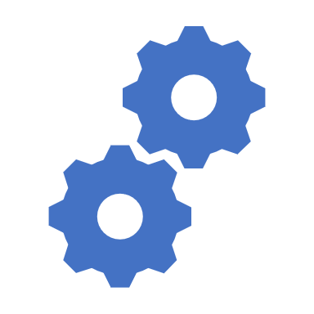
You’re doing continuous delivery when:
a. Your software is deployable throughout its lifecycle. b. Your team prioritizes keeping the software deployable over working on new features. c. Anybody can get fast, automated feedback on the production readiness of their systems any time somebody makes a change to them. d. You can perform push-button deployments of any version of the software to any environment on demand.
(...)
To achieve continuous delivery, you need:
a close, collaborative working relationship between everyone involved in delivery (often referred to as a DevOps culture)
extensive automation of all possible parts of the delivery process, usually using a deployment pipeline*".

Slide 25
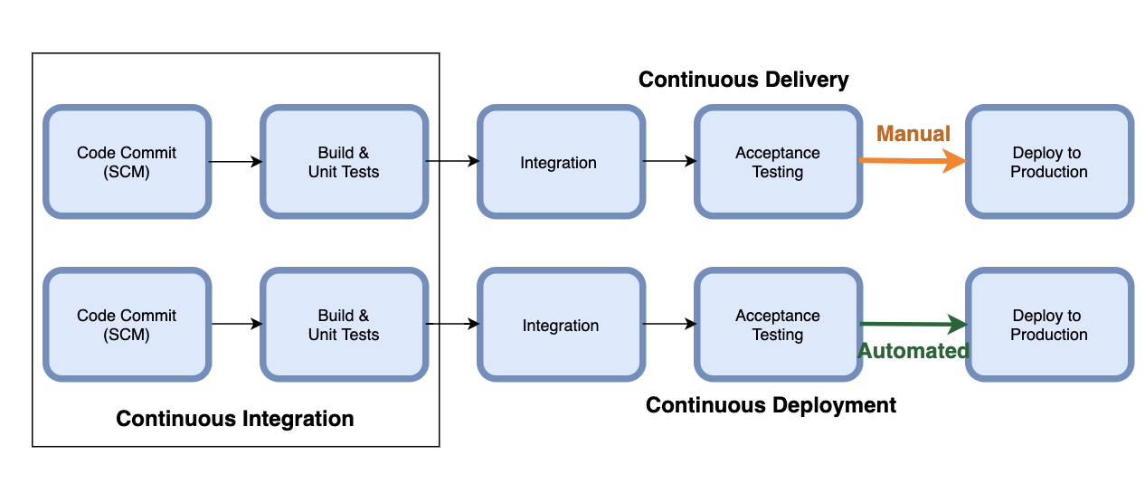
Continuous Deployment
Oftentimes, the terms Continuous Delivery and Continuous Deployment are used synonymously by many, but in reality, these concepts have a different meaning.
While Continuous Delivery gives you the capability to deploy to production frequently, it does not necessarily mean that you are automating the deployment. You may need manual approval prior to deploying to production, or your business may not want to deploy frequently.
Continuous Deployment, however, is an automated way of deploying your releases to production. You need to be doing continuous delivery in order to be able to perform automated deployment. Companies like Netflix, Amazon, Google, and Facebook automatically deploy to production multiple times a day.

Slide 26
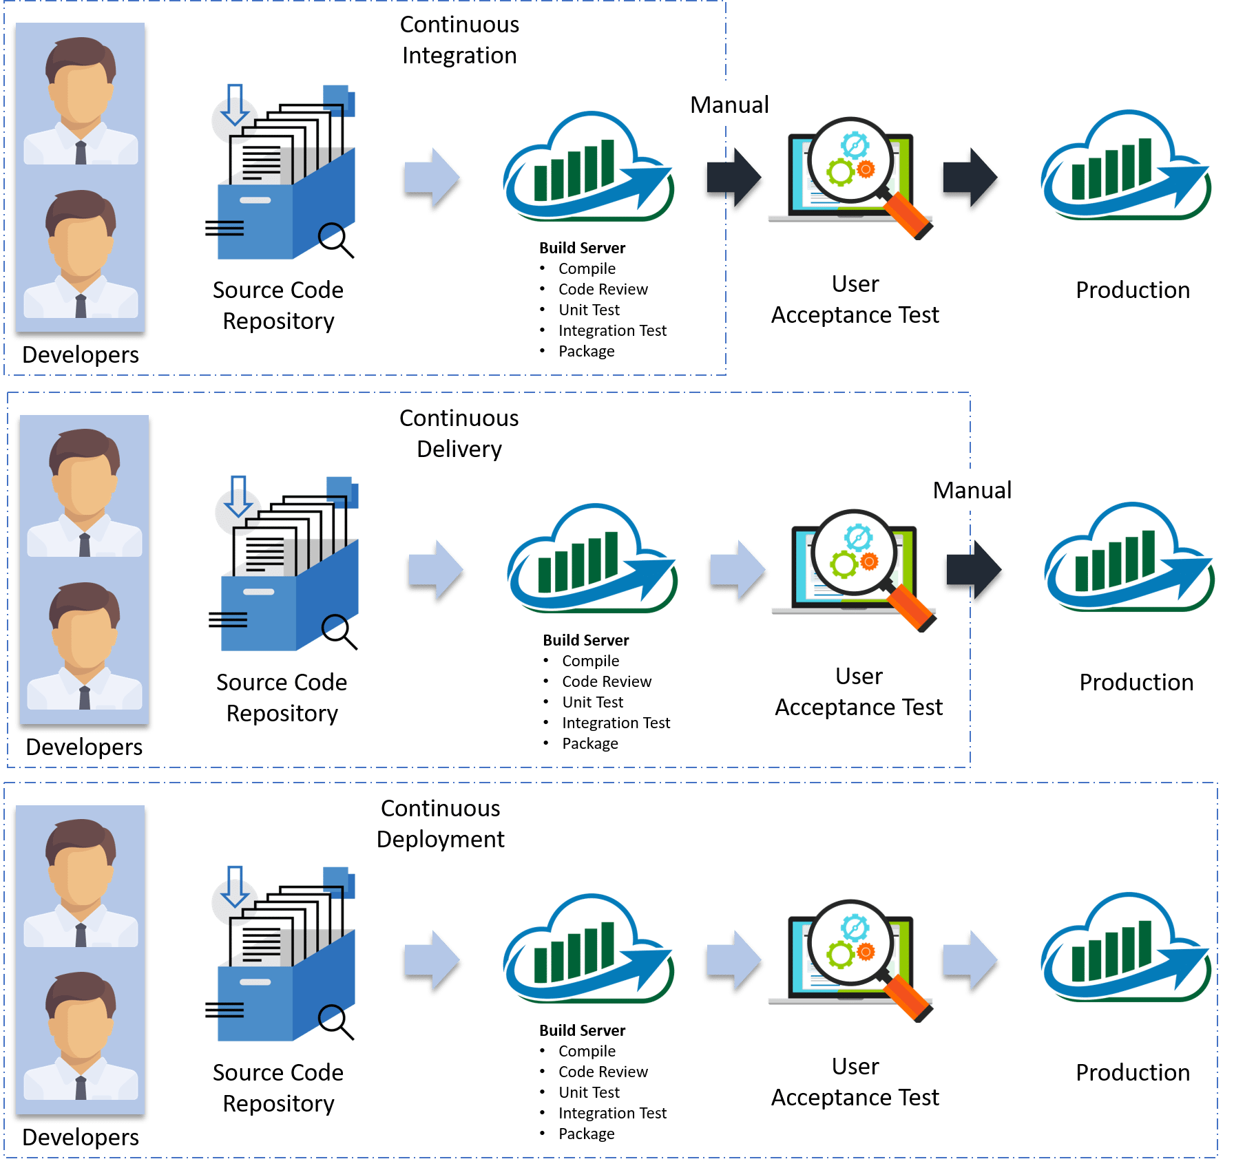
Differences Between Continuous Integration, Delivery, and Deployment
In Continuous Integration, every code commit is built and tested, but is not in a condition to be released. I mean the build application is not automatically deployed on the test servers in order to validate it using different types of Blackbox testing like - User Acceptance Testing (UAT).
In Continuous Delivery, the application is continuously deployed on the test servers for UAT. Or, you can say the application is ready to be released to production anytime. So, obviously Continuous Integration is necessary for Continuous Delivery.
Continuous Deployment is the next step past Continuous Delivery, where you are not just creating a deployable package, but you are deploying it in an automated fashion.
Let me summarize the differences using a table:
In simple terms, Continuous Integration is a part of both Continuous Delivery and Continuous Deployment. And Continuous Deployment is like Continuous Delivery, except that releases happen automatically.
But the question is, whether Continuous Integration is enough

Slide 27
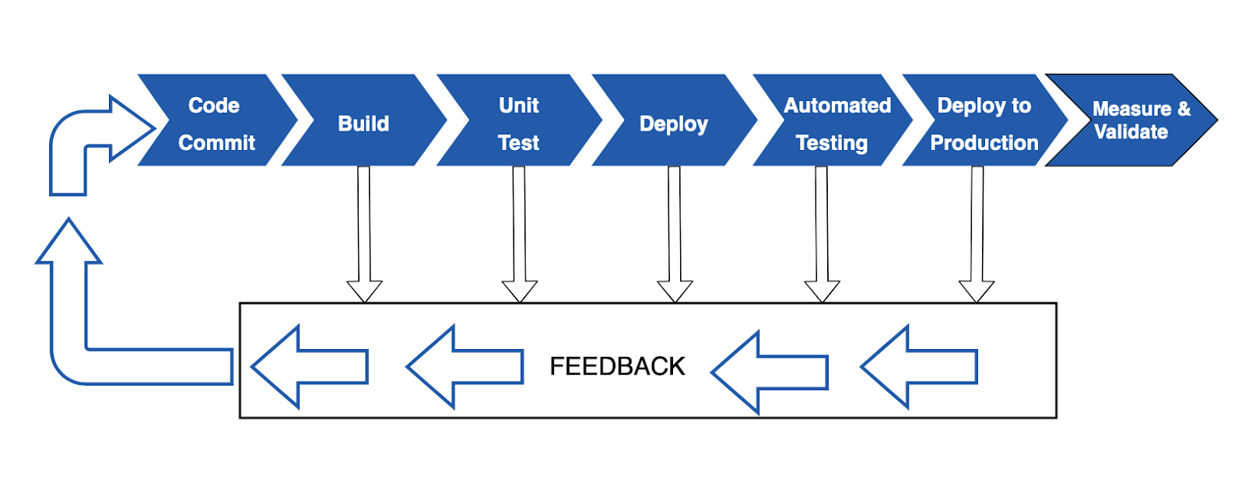
Deployment Pipelines
Deployment pipelines (or Continuous Delivery pipelines) are the cornerstone of Continuous Delivery as they automate all the stages (build, test, release, etc.) of your software delivery process.
There are numerous benefits to using Continuous Deployment pipelines. An automated pipeline allows all stakeholders to monitor the progress, eliminates the overhead of all the manual work, provides quick feedback, and more importantly builds confidence on the code quality.
The deployment pipeline run starts with a developer committing source code change into a version control repository. The CI server detects the new commit, compiles the code, and runs unit tests. The next stage is deploying the artifacts (files generated from a build) to staging or a feature test environment where you run additional functional, regression, and acceptance tests. Once all the tests are successful, you are ready to deploy into production. In case of failure during any stage, the workflow stops and an immediate feedback is sent back to the developer.

Slide 28
Tools for Deployment Pipeline
In order to automate the various stages of your deployment pipeline, you will need multiple tools. For example:
a version control system such as Git to store your source code
a Continuous Integration (CI) tool such as Jenkins to run automated builds
test frameworks such as xUnit, Selenium, etc., to run various test suites
a binary repository such as Artifactory to store build artifacts
configuration management tools such as Ansible
a single dashboard to make the progress visible to everyone
frequent feedback in the form of emails, or Slack notifications.
And that’s not all. You will also need a single tool that can bring all these tools together to achieve CI/CD goals which is to automate software delivery.

Slide 29
CI/CD Tools
CI/CD Tools | Feature: Pricing | Feature: Licensing | Feature: Hosting | Feature: Extensions/ Plugins
Atlassian Bamboo | Paid | Closed | On-premises | **
Bitbucket Pipelines | Paid | Closed | Cloud/ On-premises | **
AWS CodePipeline | Paid | Closed | Cloud | *
Azure Pipelines | Paid | Closed | Cloud | **
Circle CI | Paid | Closed | On-premises/ Cloud | ***
CloudBees Core | Paid | Closed | On-premises/ Cloud | *****
GitHub Actions | Paid | Closed | On-premises/ Cloud | ***
GitLab CI/CD | Free/Paid | OSS/Closed | On-premises/ Cloud | *
Google Cloud Build | Paid | Closed | Cloud | **
Jenkins | Free | OSS | On-premises/ Cloud | *****
Travis CI | Paid | Closed | On-premises/ Cloud | ***
There is many open sources (free) and enterprise (paid) CI/CD tools available in the market. Here is a matrix that compares some of the most popular CI/CD tools based on the type of offering (paid or free), licensing (open source or closed source), hosting (on-premise or cloud), and extensions/plugins.

Slide 30
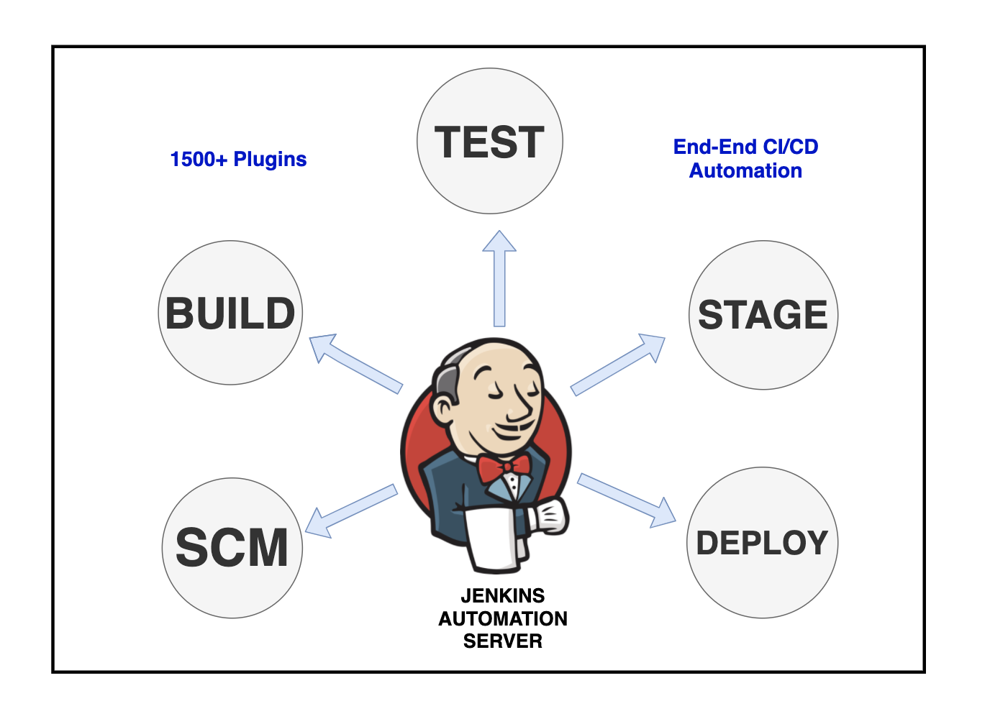
GitLab CI/CD vs Jenkins
there are only two free options, GitLab CI/CD and Jenkins. However, GitLab community edition does not give you the flexibility to use a version control repository of your choice and does not offer very many integrations through the plugins. On the other hand, Jenkins is a free and open-source tool that has stood the test of time. It has been around for over 15 years. It has a large and active open-source community constantly rolling out new releases, bug fixes, etc. There are many online sources (documentation, Google groups, etc.) for help.
Jenkins can be installed on any operating system on-premise, or in cloud. Its solid integration with many other third tools makes it an excellent choice.

Slide 31
Hudson
Hudson is a CI (continuous integration) tool which is written in Java, which runs in a servlet container such as Glassfish or Apache Tomcat application server. It supports SCM tools such as Git, CVS, Perforce, ClearCase and RTC and can execute Apache Maven and Apache Ant-based projects, as well as arbitrary shell scripts and Windows batch commands.
There are following features of Hudson:
Hudson is open-source and free.
Ease of installation and use
You can easily write plugins to support tools/processes in your team. And after you give, they can be used by others as well. Distributed build support
Inter team support
Extensive control outside Hudson and this is possible because of programmable control interface
Hudson is used in providing easily readable URLs for most of the pages such as "last successful build" and "promoted build".
Localization is available in French, English, Germany, Japanese, Russian, Turkish, and Brazilian. Even you can easily create your own localization bundle.
Hudson builds on general-purpose building blocks.

Slide 32
Jenkins
Jenkins is the most popular open-source automation server that was written in a java programming language. It facilitates the automation process of continuous integration and continuous delivery (CI/CD) in the software development process.
Jenkins supports over 1,400 plugins for other software tools. These plugins expand Jenkins into five years; platforms, UI, administration, source code management, and build management.
Jenkins is easy to install and use. It provides an impressive browser-hosted project management dashboard.
Some of the common reasons to evaluate and choose Jenkins are:
Open-source and free
Widely used and well documented
Vibrant user community
Integration with a large variety of tools and technologies.
Plugin support
Easy to install, configure and upgrade
Distributed builds
Monitoring external jobs
Support for various authentication methods, notification, version control system, etc.

Slide 33
Jenkins vs Hudson Comparison Table
Jenkins | Hudson
Jenkins is extendable open-source continuous integration server. | Hudson is Extensible continuous integration server.
Jenkins was forked from Hudson. | Hudson is the CI tool.
Jenkins is used by companies Netflix, Facebook, ebay, LinkedIn, Instacart etc. | Hudson is used by companies Logo Yazilim, TableAir UAB and OptoSweden AB.
Jenkins is integrated with Slack, Datadog, BrowserStack, Sauce Labs, JBoss, etc. tools. | Maven is integrated with tools JavaScript, Java, HTML5 and Tuleap.
Jenkins support a lot of plugins. | Hudson support less plugins as compare to Jenkins
There is no such difference between Hudson and Jenkins. Jenkins is the renamed version of Hudson.
After disagreements between Oracle and Hudson creators, the latter decided that Hudson was to be forked and Jenkins CI. Jenkins is the continuation of the Hudson open-source project, under the original creator and towards an open-source future; Hudson is now under the Oracle's wing with more structure around it.

